Slide 1
Smart Dustbin
The main objective of the project is to design a smart dustbin which will help in keeping our environment clean and also eco friendly. We are inspired from Swaach Bharat Mission. Nowadays technologies are getting smarter day-by-day so, as to clean the environment we are designing a smart dustbinby using Arduino. This smart dustbin management system is built on the microcontroller based system having ultrasonic sensors on the dustbin. If dustbin isnot maintained than these can cause an unhealthy environment and can cause pollute that affect our health. In this proposed technology we have designed a smart dustbin using ARDUINO UNO, along with ultrasonic
sensor, servo motor, and battery jumper wire.

Slide 2
INTRODUCTION:
The rate increasing population in our country has increasing rapidly and also we have increase in garbage which have increased environmental issue. Dustbin is a container which collects garbage’s or stores items which recyclable or non-recyclable, decompose and non-decompose. They are usually used in homes, office etc, but in case they are full no one is there to clean it and the garbage are spilled out.
The surrounding of a dustbin is also conducive for increasing the pollution level. Air pollution due to a dustbin can produce bacteria and virus which can produce life harmful diseases for human. Therefore, we have designed a smart dustbin using ARDUINO UNO, ultrasonic sensor which will sense the item to be thrown in the dustbin and open the lid with the help of the motor.
It is an IOT based project that will bring a new and smart way of cleanliness. It is a decentgadget to make your home clean, due to practically all offspring of home consistently make it grimy and spread litter to a great extent by electronics, rappers and various other things.

Slide 3
METHODOLOGY
ARDUINO is an IOT based project. Here we are using arduino for code execution, for sensing we used ultrasonic sensor which will open lid and wait for few moment. It will bring drastic changes in tern of cleanliness with thehelp of technology. Everything is getting with smart technology for the betterment of human being. So this help in maintaining the environment clean with the help of technology. It is a sensor based dustbin so it would be easy to access/use for any age group.Our aim is also to make it cost effective so that many numbers of people can get the benefit from this. And it should be usable to anyone and helpful for them.

Slide 4
REQUIREMENT
ADUINO IDE PLAYS AS A SOFTWARE
ARDURINO UNO
ULTROSONIC SENSOR
SERVO MOTOR
9V BATTERY
DUSTBIN

Slide 5
PROCEDURE
The Smart Dustbin using Arduino. First, I will start with the mechanism toopen the lid. As you might have already guessed, I have used a Servo Motor for this purpose. In order to open the lid, I have fixed a small plastic tube (like an empty refill of a ball-point pen) to the servo horn (a single ended horn) using instantglue. For this mechanism to be able to open the lid of the dustbin, it must be placed near the lid.In this the actual setup of dustbin design and build the system by using Arduino. Starting with the mechanism of opening the lid of dustbin, for this purpose Servo motor has been used. To open the lid, I have attached a small plastic tube (like an empty refill of a ball-point pen) to the servo horn (a single ended horn) using instant glue.
After successfully servo motor is placed now it’s time for sensor, so HC-SR04 Ultrasonic sensor isplaced at the front of the dustbin.

Slide 6
The final step in the build process is to make the necessary connections using long connecting wires as per the circuit diagram and securing these wires so that they don’t hang around. All the wires from both the components i.e. Ultrasonic Sensor and Servo Motor are connected to respective pins of Arduino. This finishes up the build process of the
Smart Dustbin. In Arduino Code has been submitted, and with all hardware and software connection in Dustbin. We will run our dustbin,wait its working or not.

Slide 7
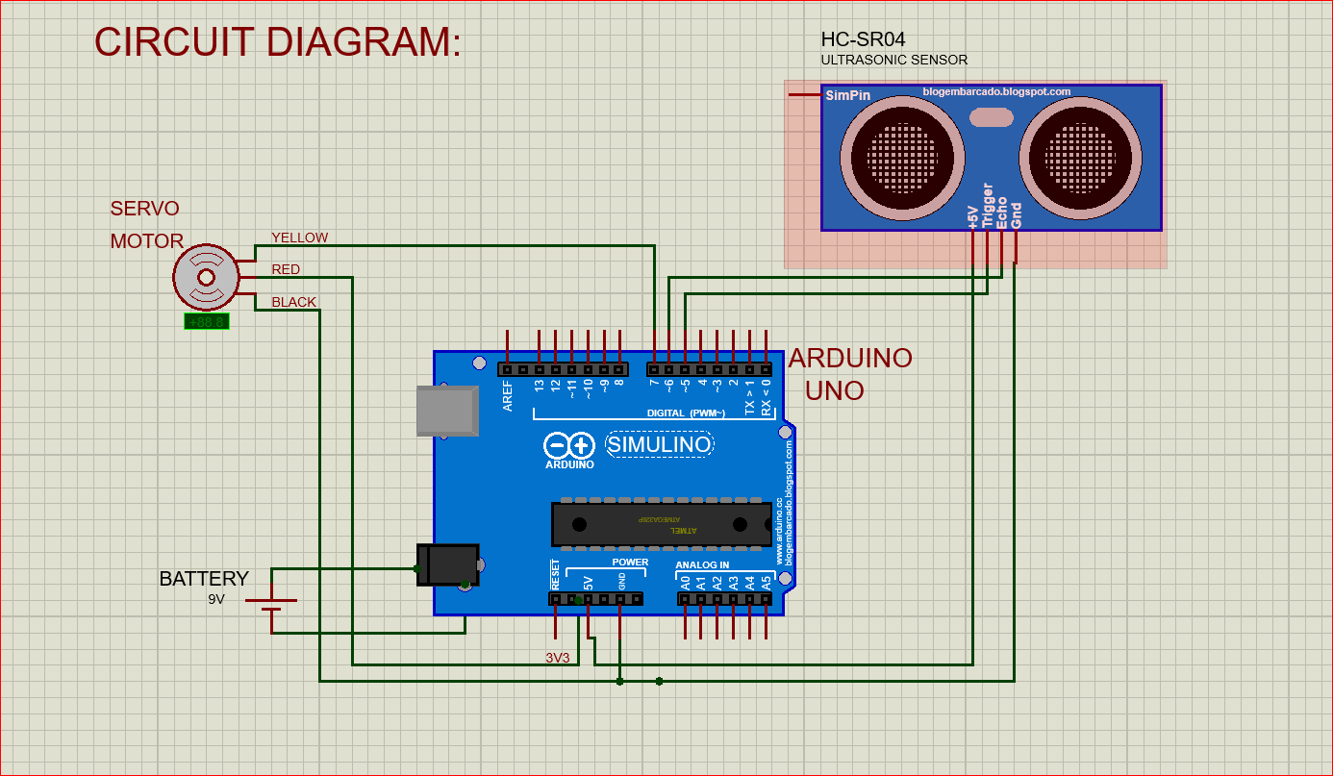
Circuit diagram

Slide 8
The ultrasonic sensor echo pin and trigger pin is connected to pin digital pin D7 and D8. The + Vcc pin is connected to +5V supply and GND pin is connected to ground pin of arduino Unoboard. The control (PWM) pin of servo motor isconnected to digital pin D9 of arduino. Hence, servo motor is used to open the cap of dustbin.For this project and components used, the presetlevel of distance between dustbin and hand isfixed to 40 cm.

Slide 9
Ultrasonic Sensor: This sensor is used in to locate the distance between the smart dustbin and hand/object come near to it. The principle behind finding distance of obstacle is sonar wave. It only detects obstacle when Trigger pin receive high pulse for the period more than 10 us. When this sensor verifies the presence of hand (obstacle) it starts to send eight cycles of ultrasonic burst at 40KHz and then it waits for reflected ultrasonic signal. Ultrasonic sensor module has two drums. One of the drums is used for transmitting the pulse of ultrasonic and the second drums are for receiving the ultrasonic signal.

Slide 10
Initially, the cap of dustbin is switched back to zero-degree position (Close) by the servo motor. The controller keeps on monitoring the signal receive from ultrasonic module. When ultrasonic module detects an obstacle, the controller check if it crosses a threshold distance value set for open the cap of dustbin.
As soon as that happens, the controller triggers the servo motor when then open the cap for limited line (as set in code part). For this system prototype set time is given for 2 second.
Here in this project also used an ON/OFF switch, in order to activate and de-activated the smart dustbin whenever require as per situation. A pull up resistor of 10K is connected in series of switch as shown in circuit diagram in order to solve the de-bouncing problem.

Slide 11
WORKING
After wiring and attaching all the devices and setting up to the Smart Dustbin, now observe all the important setup whether they are well connected or something missed. After connection set up now next step is to submit/upload code in Arduino and supply power to the circuit. When system is powered ON, Arduino keeps monitoring for any things that come near the sensor at give range. When Ultrasonic sensor detect any object for example like hand or others, here Arduino calculates its distance and if it less than a certain predefines value than servo motor get activate first and with the support of the extended arm of the lid. Lid will open for a given time than it will automatically close.

Slide 12
ADVANTAGES
Following are the advantages of using Smart dustbin:
=> A reduction in the number of waste
collections needed by up to 80%,resulting in less manpower, emissions,
fuel use and traffic congestion.
=> A reduction in the number of waste
bins needed.
=> Maintain environment hygiene (i.e. no
overflowing of waste and less
unpleasant odor).
=> It will help in bringing evolution by
technology in term of cleanliness.

Slide 13
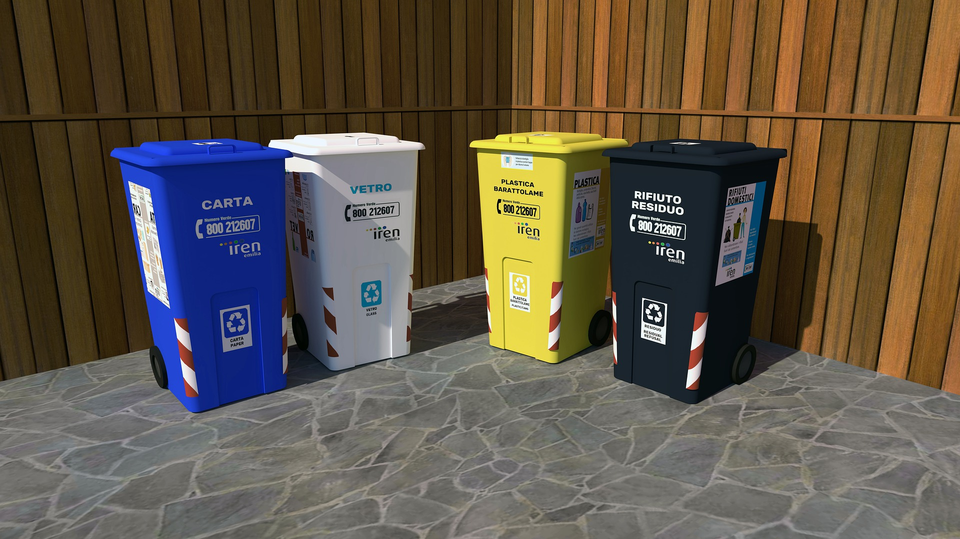

Slide 14
CONCLUSION AND SUGGESTION
Here we are going to make an evolution changes toward cleanliness. The combination of intelligent waste monitoring and trash compaction technologies, smart dustbins are better and shoulders above traditional garbage dustbin. It is equipped with smart devices like sensor Arduinoetc.Lid of the dustbin will automatically open when an object comes near to the dustbin and after certain time period it will close the lid.
For social it will help toward health and hygiene, for business for we try to make it affordable to many as many possible. So that normal people to rich people can take benefit from it. Believe this will bring something changes in term of cleanliness as well technology.So our next work will be adding one more sensor which will sense whether our dustbin is full or not. And there will be a display will be added so that user can notify that dustbin is full or not.

